Slide 1
Clustering
Tugay Abdullazade
a8z1v4@inf.elte.hu

Slide 2
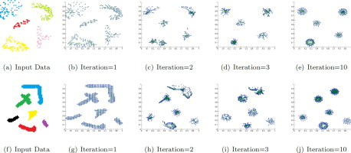
Clustering
Clustering is the task of separating items of different type by agents.
Goal is to successfully create clusters of items within the shortest amount of time.
Image(s)
2024. 09. 17.
2

Slide 3
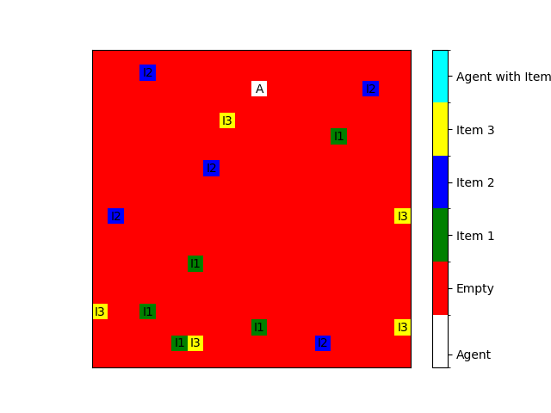
Environment
2D Enviroment loosely using pettingzoo
With customizable area (default 20x20)
Each individual block is 1x1
Image(s)
2024. 09. 17.
3

Slide 4
Observation spaces
Agents can see 3 pixel distance
Both items and the other agents can be seen by agents.
2024. 09. 17.
4

Slide 5
Action spaces
Up
Down
Right
Left
Pick up
Drop
2024. 09. 17.
5

Slide 6
Models and Policies
Models
LSTM (couldn’t get it to work)
Policies
PPO
2024. 09. 17.
6

Slide 7
Rewards
Positive
Being close to other items
Picking up
If there is no item being carried
Dropping
If carrying
Negative
Carrying items more
Picking up if already carrying an item
Dropping if not carrying an item
2024. 09. 17.
7

Slide 8
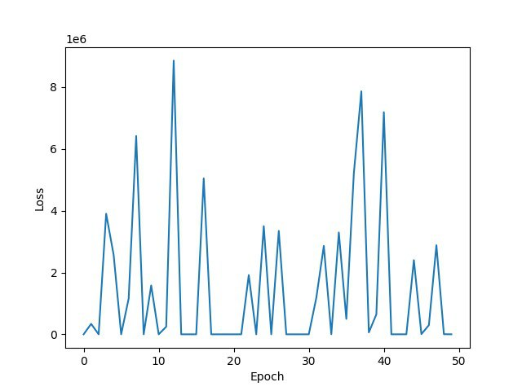
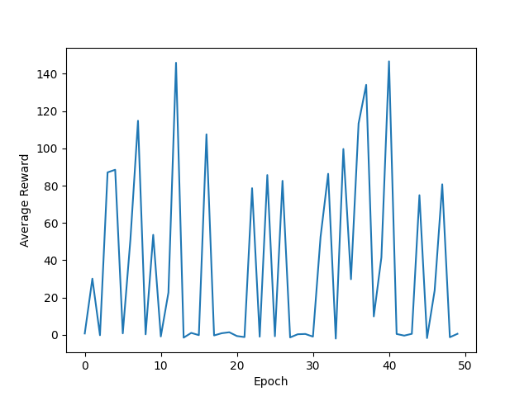
Training
Epochs: 50
Episodes: 100
Agents: 2
2024. 09. 17.
/
8

Slide 9
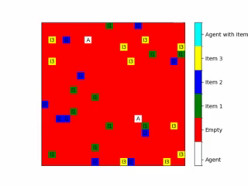
Result

Slide 10
Conclusion
Conclusion
Further Work
….
2024. 09. 17.
10

Slide 11
Thank You for Your attention!
Tugay Abdullazade
a8z1v4@inf.elte.hu
Questions?
2024. 09. 17.
11

